Slide 1


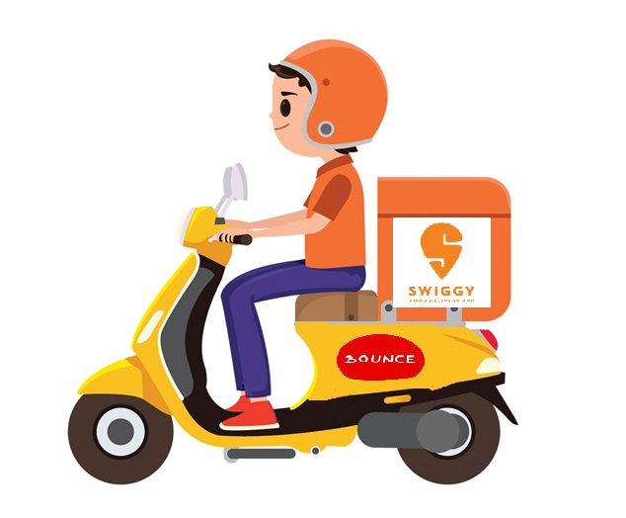
Swiggy (Food Delivery App) Marketing Analysis
Submitted To : Prof. Pratik Bedi Submitted By: Alisha Mahajan (0802631)

Slide 2
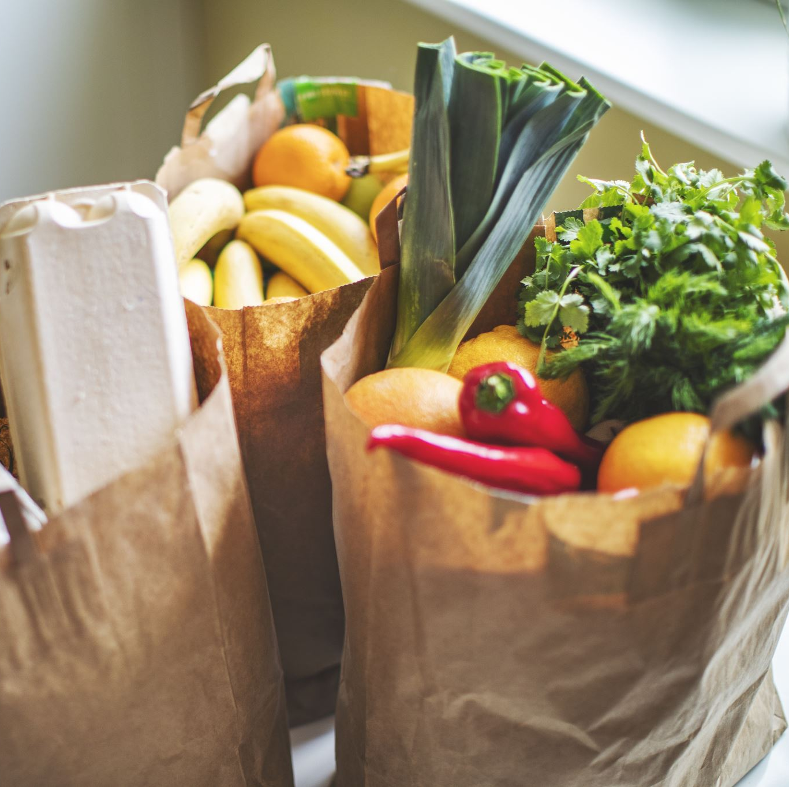
INTRODUCTION & MOTIVATION
Swiggy is an online food ordering and delivery service based in India. As of September 2021, Swiggy—which was founded in 2014—operates in over 500 Indian cities and has its headquarters in Bangalore. In addition to food delivery, the platform offers same-day package delivery service named Swiggy Genie and on-demand grocery deliveries under the brand Instamart. This project aims to leverage the dataset to gain insights into customer preferences, ordering habits, and regional variations in the context of online food delivery.
In the hyperlocal marketplace and meal delivery space, it competes with domestic upstart Zomato.

Slide 3

Market Problem
The Swiggy restaurant dataset comes with a number of difficulties and issues with the market. The key marketing problem to be addressed is customer segmentation. A technique for segmenting the market into discrete consumer groups with comparable attributes is customer segmentation. Leveraging insights from customer preferences, restaurant popularity, delivery times, and ratings, the project seeks to identify key customer segments. The goal is to tailor marketing strategies, promotions, and collaborations to effectively target and serve these identified segments. The type of restaurant, regional data, and behavioural elements like patron spending trends, usage patterns, and preferences can all be taken into account when segmenting this market. Swiggy can better meet the varied needs of various consumer groups by customizing its services, promotions, and offerings with an understanding of customer segmentation.

Slide 4

=> Above in Competitions. => Growing fast. => Regular offers. => Great Discounts. => Coupons Availability.

Slide 5
SWOT ANALYSIS
Strengths:
Quick Delivery: Swiggy is known for fast and on-time food delivery.
Skilled Team & Expansion: A well-trained team has helped Swiggy expand its services to 100 cities.
Free Delivery Options: Swiggy provides free delivery based on factors like location and order value.
Clean Packaging, Diverse Choices: Ensures clean and hygienic packaging; offers a variety of restaurant choices for customers.
Weakness:
Location Constraints: Swiggy currently limits orders to nearby restaurants, missing out on potential customers looking for a broader range of options.
Delivery Charges for Orders Below Rs. 250: Swiggy imposes delivery fees on orders below Rs. 250, unlike competitors like Zomato, which offer free delivery for lower bill amounts. Swiggy may need to reconsider this approach.
Opportunities:
Pioneering Role: Swiggy pioneered minimal-charge home delivery, revolutionizing the food delivery industry.
Customer Growth: Swiggy's commitment to quality service has led to a consistent increase in its customer base, expanding its market presence.
Operational Enhancement: To compete effectively, Swiggy should expand its network of zonal restaurants, focusing on collaborations with local establishments.
Threats:
Rising Health-Conscious Consumers.
Underestimation of potential rivals.
Increase in competitive landscape.
Current customer base remains limited.

Slide 6
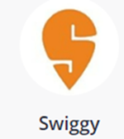
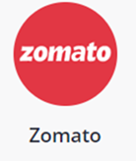
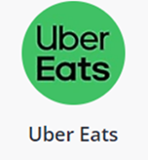
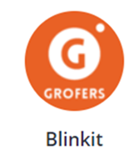
Swiggy Competitors
On-demand food delivery platform. | Restaurant search and discovery platform. | Uber's food delivery service. | Mobile e-commerce for daily needs.
Total Employees: 11,086 | Total Employees: 3,755 | Total Employees: N/A | Total Employees: 3,930
Total Employee Ratings: * 4.2 | Total Employee Ratings: * 4 | Total Employee Ratings: * 3.5 | Total Employee Ratings: * 3.9
Net income: (₹4b) (FY, 2018) | Net income: (₹9.7b) (FY, 2023) | N/A (On Jan 2020, uber eats was acquired by Zomato) | Net income: (₹3b) (FY, 2023)

Slide 7
Swiggy vs Zomato
Restaurant Partners:
Zomato: 390,000+
Swiggy: 128,000+
Market Share:
Swiggy: 54%
Zomato: 46%
Geographic Reach
Swiggy: 200+ cities
Zomato: 100+ cities
Financials (FY 2022):
Swiggy Revenue: Rs 5,704.9 crores
Zomato Revenue: Rs 4,687.3 crores

Slide 8
Dataset:
Source:
Swiggy Restuarants dataset (kaggle.com)
The Swiggy Restaurant Dataset offers a valuable opportunity to explore customer behavior and interactions with this platform. The Dataset has been captured from Kaggle. It consist of 8681 rows and 10 columns, which covers a specific time period, providing insights into various aspects of restaurants, including their geographical locations, pricing, customer ratings, types of cuisines offered, and delivery-related information. An analysis of this dataset can unveil patterns in restaurant distribution, identify popular cuisines, assess customer ratings, and reveal other factors crucial to the food delivery business.

Slide 9
Features:
no. (Number): A unique identifier or serial number for each entry in the dataset.
Area: The locality or neighborhood where the restaurant is located.
City: The city in which the restaurant is situated.
Restaurant: The name of the restaurant.
Price: The price range or cost associated with the restaurant (in the local currency).
Avg ratings: The average ratings given by customers to the restaurant.
Total ratings: The total number of ratings received by the restaurant.
Food type: The type of cuisine or food offered by the restaurant.
Address: The specific address or location of the restaurant.
Delivery time: The time taken by the restaurant for food delivery.

Slide 10
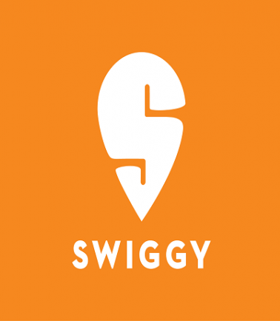
EDA

Slide 11
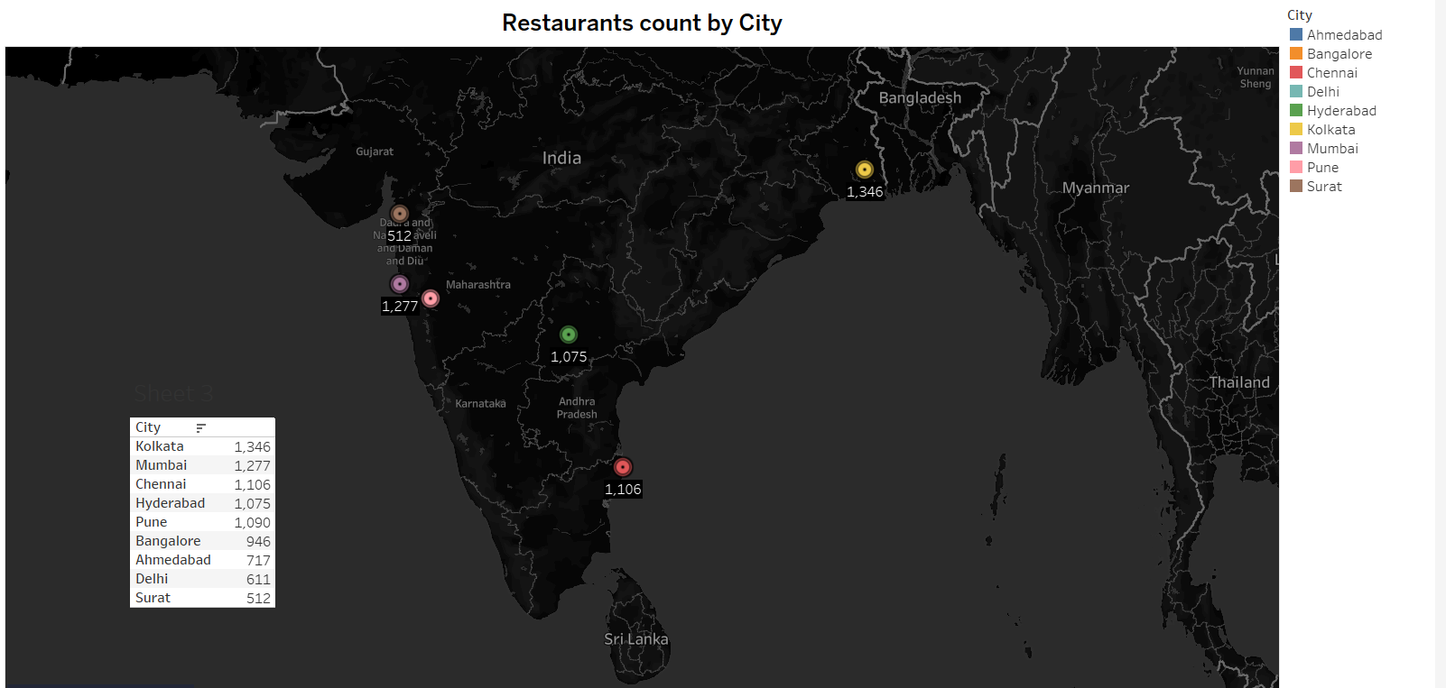
Map Showing the Count of Restaurants by City
This map shows the cities in India with the maximum number of restaurants listed on Swiggy. Kolkata has the highest number of listed restaurants i.e. 1346, followed by Mumbai (1277) and Chennai (1106)
This data can be used to tailor marketing strategies, offers, and service enhancements specifically for these high-demand areas. To understand the customer base or demand for Swiggy’s services in different areas, analyzing the concentration of listed restaurants in various cities can be helpful.

Slide 12
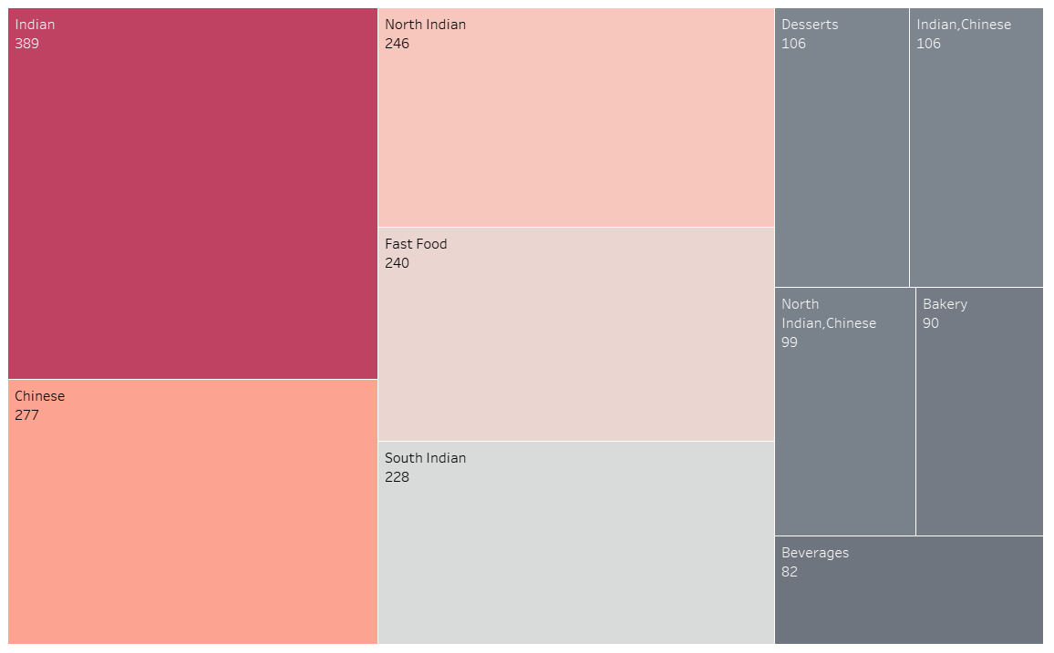
Top 10 ordered Food Types
This chart displays the Top 10 ordered food by Swiggy, in which Indian and Chinese food types are on the top and Beverages are least ordered by customers.
The majority of customers prefer Indian and Chinese cuisines, indicating a significant market segment that favors these two types of cuisines. Swiggy can tailor its marketing strategies, offers, and recommendations to cater to this large segment..

Slide 13
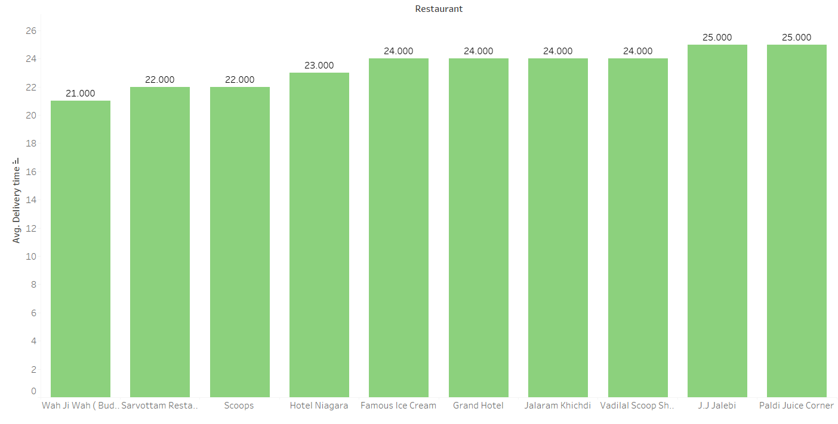
Top 10 Restaurant with minimum Delivery Time
This chart shows the top 10 Swiggy affiliated restaurant with minimum delivery time. The average delivery time for all the restaurants is around 20-25 minutes, which is most efficient timings for food delivery.
The emphasis on quick delivery aligns with Swiggy's goal of offering a seamless and efficient food delivery experience, contributing to customer satisfaction and loyalty. As Swiggy continues to prioritize partnerships with such restaurants, it reinforces the platform's reputation for reliable and timely food delivery services.

Slide 14
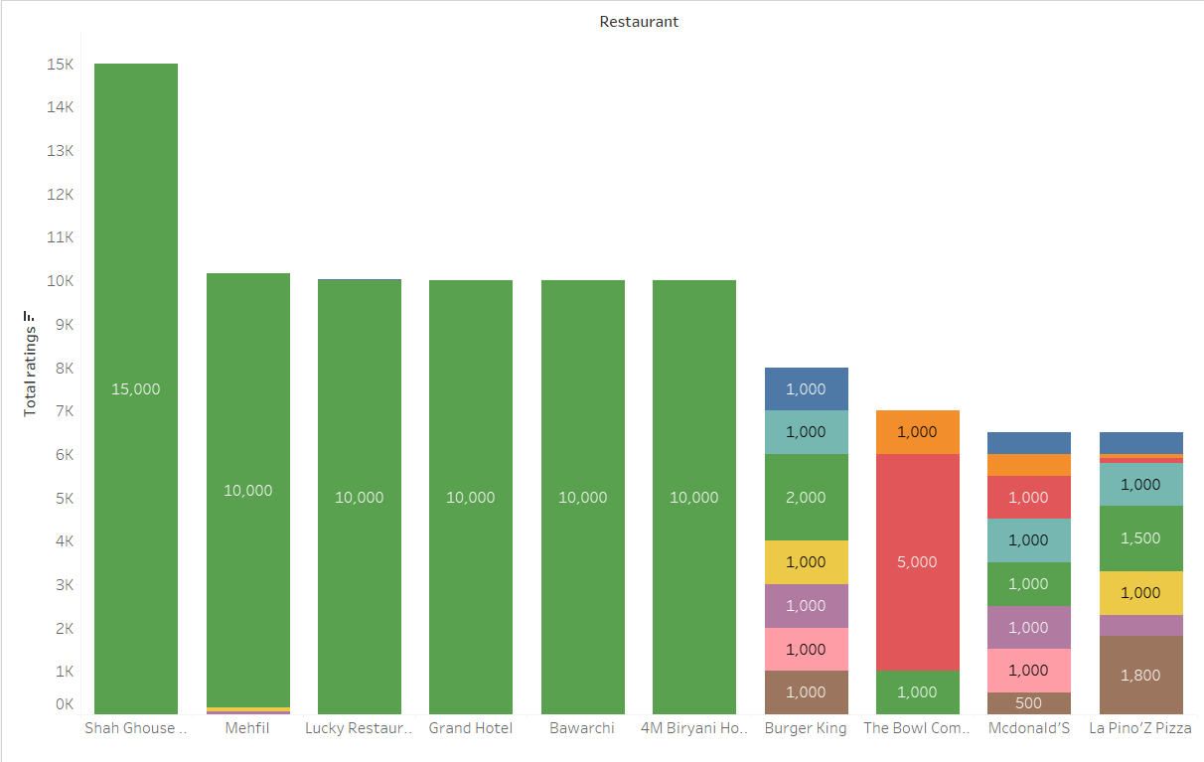
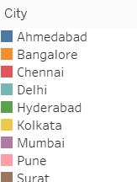
Top 10 Restaurant by Total Ratings
This graphs highlights the total ratings received by top 10 restaurants in 9 cities, allowing us to pinpoint those with the highest customer satisfaction on the Swiggy platform.
Restaurants such as Shan Ghouse, Mehfil, Lucky Restaurant, Grand Hotel emerge as top performers, indicating their popularity and positive reception among Swiggy users. These restaurants with high ratings are valuable assets for Swiggy, as positive customer feedback contributes to the platform's reputation and customer trust.
Analyzing of customer ratings will help swiggy marketing to enhance their customer base and customer relationships.

Slide 15
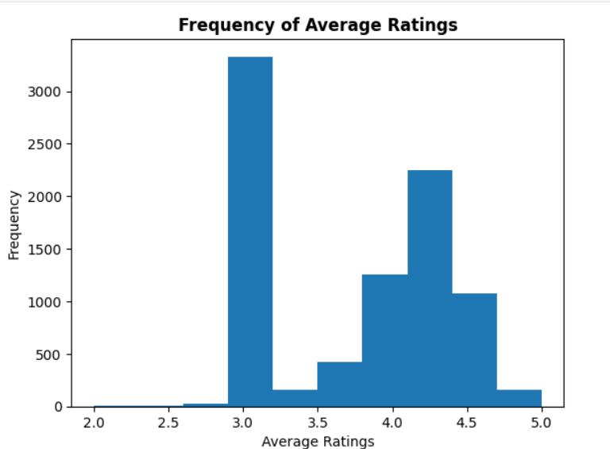
Frequency of Average Ratings of the restaurants
The bar graph shows how often restaurants on Swiggy are rated on average. A lot of restaurants have an average rating of around 3.0, which means that many Swiggy customers are giving a neutral rating. Fewer restaurants have ratings between 3.5 and 4.0, and even fewer have ratings above 4.0, which suggests that higher-rated restaurants are less common on the platform.

Slide 16
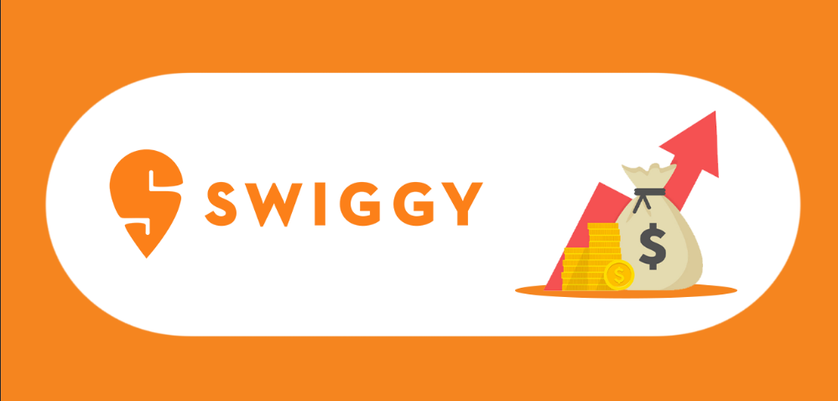
Models:
Decision tree
Random Forest
Interpretation: It can be seen in Jupyter Notebook:
The MSE values are metrics to measure the performance of regression models. A lower MSE indicates better performance.
In this case, the Random Forest Regressor has a lower MSE (0.0084) compared to the Decision Tree Regressor (0.01647), suggesting that the Random Forest model is performing better on this particular test set. It generally aligns with the intuition that Random Forests often outperform individual Decision Trees.

Slide 17
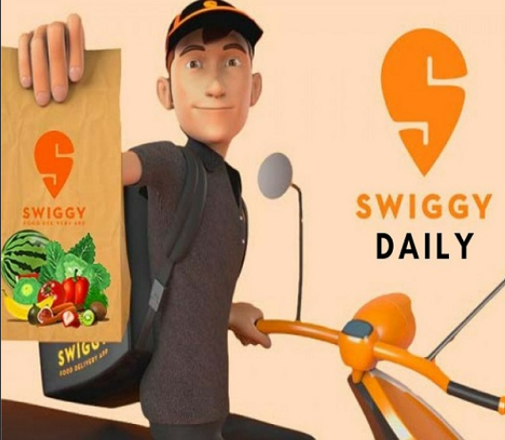
Swiggy Present Marketing Strategies:
1. Supreme Data Analysis:
Personalized notifications based on extensive client knowledge.
Utilizes data analysis for B2B expansion and customer insights.
2. Distribution Strategy:
Hyperlocal product delivery beyond food to include medicines, groceries, etc.
Dual partnership approach benefiting both customers and establishments.
3. Technological-Focused Marketing:
Core logistics platform relies on technology for optimal service.
Data analytics for intelligent logistics and service improvement.
4. Promotional Strategies:
Makes funny ads and works with popular people.
Talks a lot on social media and sends emails to customers.

Slide 18
Future Marketing Strategies:
Retaining the old customer by providing specific benefits based on purchasing patterns.
Acquiring new markets in Tier 2 and 3 cities.
Funding new restaurant/promote cloud kitchens.
Diversifying the delivery network and exploring the capabilities of the service.

Slide 19

Swiggy can become even more popular by focusing on specific groups of customers. They can do this by planning where to offer their services based on what people like in different areas. Swiggy can add a variety of restaurants to please different tastes and set prices based on how often people order. They can make sure deliveries work well for everyone and partner with local businesses. Using data, Swiggy can decide what rewards to give customers and get feedback to make things better. They can also advertise in ways that match each area's unique style to make customers even happier.

Slide 20

References:
https://craft.co/swiggy/competitors
Swiggy - Wikipedia
https://simran-pm.medium.com/market-share-swiggy-and-zomato-are-the-two-leading-food-delivery-platforms-in-india-with-swiggy-bb15ed7bdbc8
https://www.bibs.co.in/blog/a-case-study-on-swiggys-marketing-strategy

Slide 21
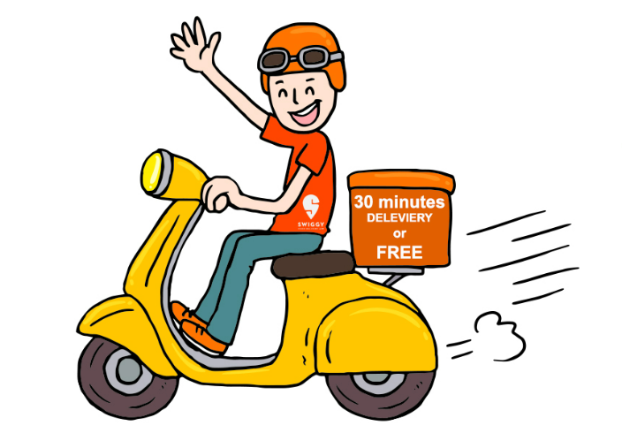
Thankyou…

